Slide 1
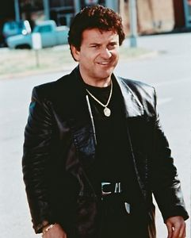
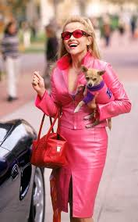
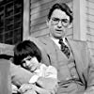
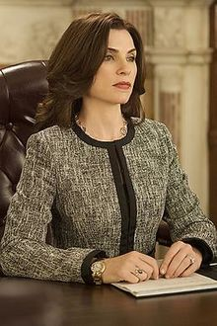
Identify these TV/movie litigators (and sidekicks) … and you may win a prize!

Slide 2
DOs | DON’Ts | WHYs
DO: ARRIVE EARLY-ALWAYS | DON’T: BE LATE OR “ON TIME” | EXPECT THE UNEXPECTED
You and “your people” (your client, witnesses, & all judge might associate with you or your client) | Count on avoiding security line bc: you’re a lawyer (with bar card), or you’re late, have 7 boxes with you | “On time” = late for court
 |  | Minimize stress/maximize confidence
Before day of court, share directions, cell numbers, other logistics | Allow your people to disrupt | Being early & settled shows respect to all in court: judge, staff, other lawyers

Slide 3
DO: LEARN ABOUT “THE COURT” … WELL AHEAD OF TIME | DON’T: ASSUME ALL COURTS OPERATE THE SAME WAY | THEY DON’T! Expect unique practices, customs, pet peeves …
From court website, local rules, judge standing order, asking colleagues, & OBSERVING COURT IN SESSION | Appear without answers to at least 5 basic questions: | The classic lawyer answer to all 5 questions is … IT DEPENDS!
Introduce yourself to courtroom staff (clerk/asst, court officer, reporter) -Make new friends! -Ask new friends questions -Be courteous & respectful | 1: Where do I sit? | 1: Left/right, P nearest jury, first dibs
 | 2: Where do I stand? | 2: Counsel tables, podium, other?
 | 3: Can I move around courtroom? | 3: If ask & judge grants permission
 | 4: Who handles exhibits? | 4: Clerk takes & hands to witness or judge
 | 5. What technology can/should/ must I use? | 5: Technology: Elmo, laptop, phone, monitors for judge/counsel/jury

Slide 4
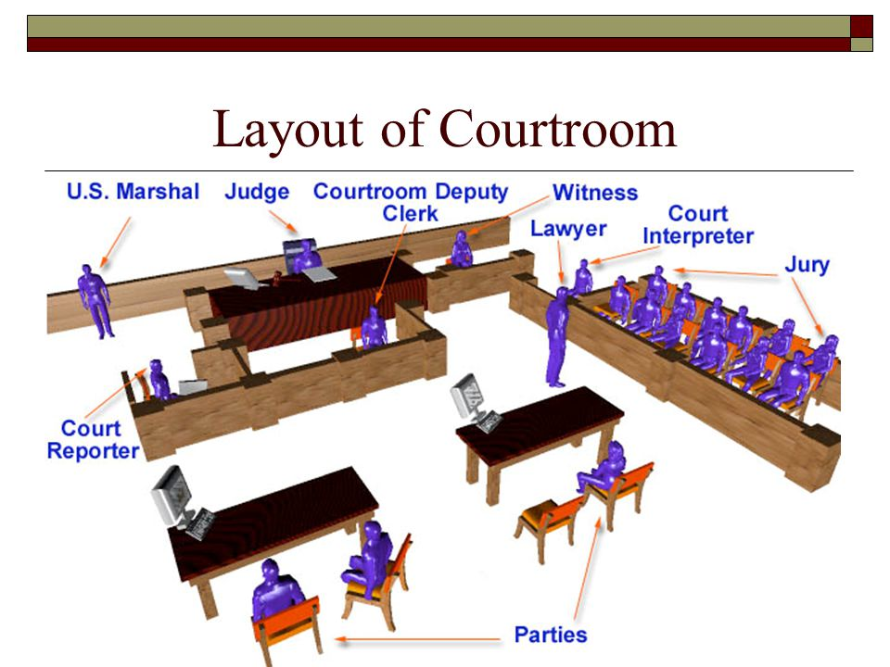

Slide 5
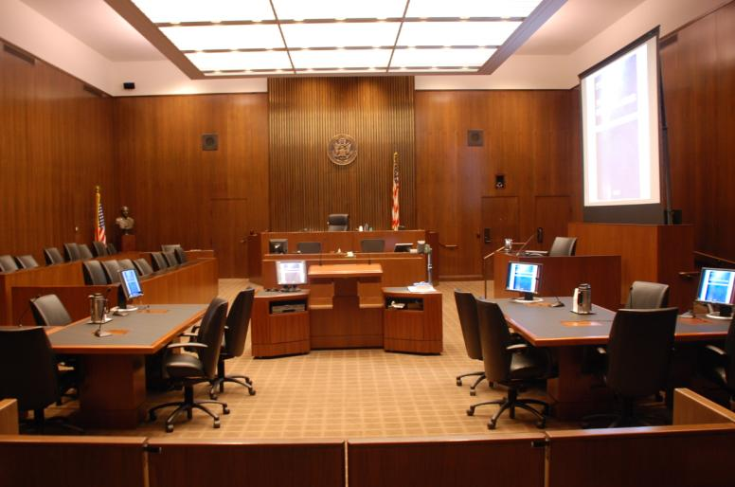

Slide 6
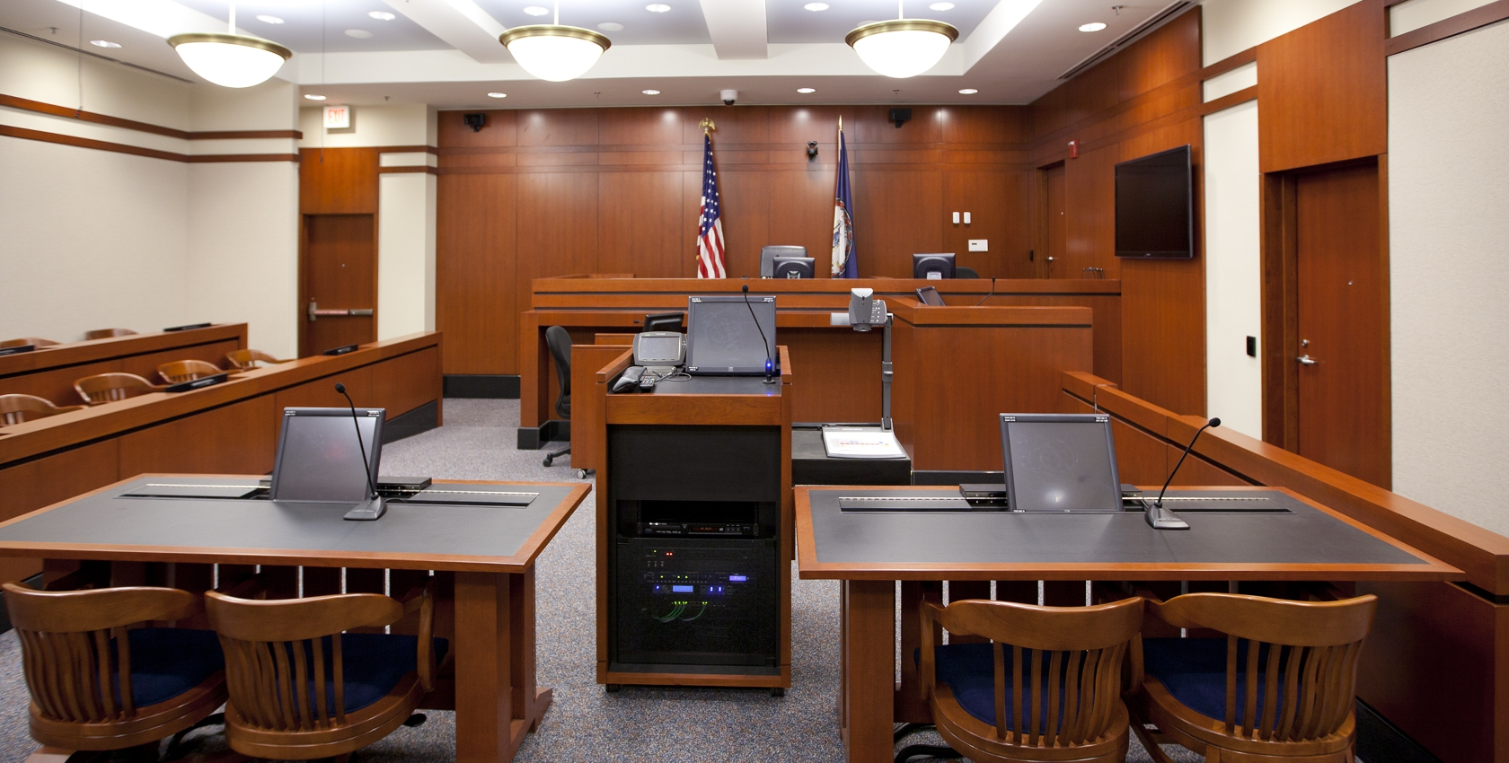

Slide 7
Differences in Courtroom Technology, Example
Worcester Federal Courtrooms
Springfield Federal Courtrooms

Slide 8
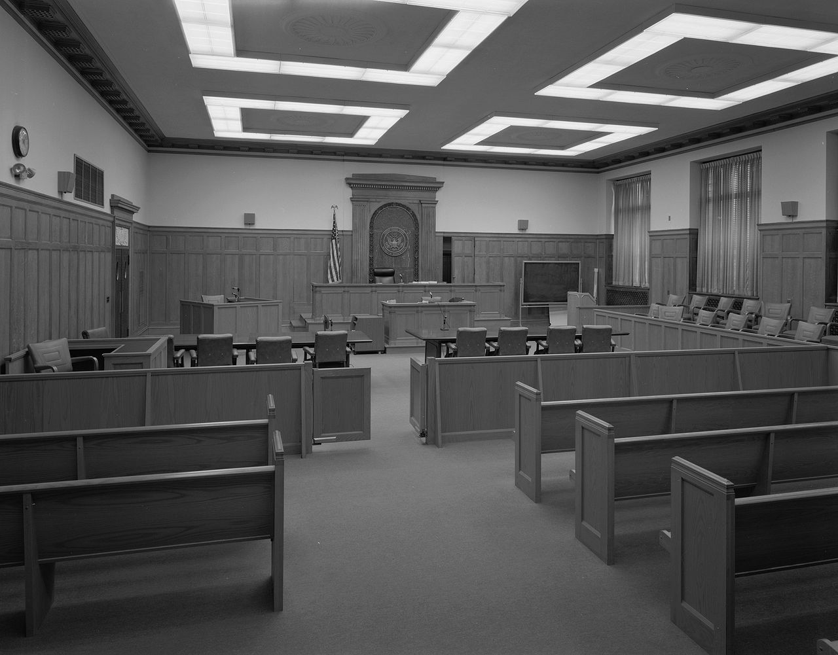

Slide 9
DO: R-E-S-P-E-C-T THE JUDGE & ERR ON SIDE OF FORMALITY | DON’T: SPEAK/ACT INFORMALLY OR DISRESPECTFULLY | COURT IS SERIOUS SITUATION FOR ALL INVOLVED-ESPECIALLY CLIENT
Stand: judge enters/leaves, you speak | Sit or rise reluctantly | Standing shows basic respect
First words always: “Your Honor …” | Use: “Judge,” “Sir” | That’s just the script in this play!
“I am [name] and I represent [client]” | Assume everyone knows you | Respectful & makes clear record
“May I” … approach, use podium, etc | Act like you own the place | Clerk or judge might “correct” you
Firmly advocate your position to judge (e.g., on motion) | Interrupt/speak over judge or argue point with adversary | Conduct will anger judge, muddy record & show inexperience
To judge: “I respectfully disagree” | Never: “With all due respect” | “All due respect” = little/no respect
Last words: “Thank you, Your Honor” | Express anger, frustration, disgust | Will anger judge & worsen situation

Slide 10
ADA Jack McCoy:
“With all due respect, your honor, when you change the rules of the game in the middle of a trial...”

Slide 11
Judge Marks: You're done, Mr. McCoy!
ADA McCoy: ...there ought to be at least the appearance of impartiality!
Judge Marks: Officer, place Mr. McCoy under arrest for contempt of this court!
ADA McCoy: I move for an adjournment so that the People may appeal your honor's ruling!
Judge Marks: Denied! Cuff him!
[the court officers slap the cuffs on McCoy and escorts him out of the courtroom]

Slide 12
DO: BE YOUR MOST PERSUASIVE SELF | DON’T: DISTRACT FROM WHY WE WIN | JOB IS TO PERSUADE & WIN
Always prepare 15-30 second WWW summary statement | Get lost in motion or witness of day & divert message from WWW | Repetition & tying evidence to WWW maximizes persuasiveness
Appear prepared & “in your element” | Show nerves (shuffle papers etc) | Competence + confidence=credibility
Dress professionally (boring is OK) | Dress-to-impress or self-express | May upset judge, distract from WWW
Treat all with courtesy & respect | Ignore or speak down to anyone | Being “nice person” helps you & case
Be aware of physical orientation in room (e.g., sightlines, eye contact) | Turn back on judge, witness, jury, or block their sightlines | Respect, factfinder must see evidence, movements→emphasis
Maintain composure & move on | Dwell on adverse ruling/setback | Shows confidence, minimizes damage
Use organization to control flow | Allow adversary to control flow | Shows confidence, supports WWW

Slide 13
Vincent La Guardia Gambino
https://www.youtube.com/watch?v=D26UIWLakb0

Slide 14
DO: GET THINGS INTO EVIDENCE | DON’T: FORGET TO DO IT | ONLY “RECORD” →JURY & APPEAL
Pretrial stipulation to authenticity (maybe) | Stip if good objection to authenticity | Stips avoid boring witness ID process
Decide witness to introduce X with | Introduce without testimony | Testimony gives documents life
Mark for identification, show adverse counsel & lay foundation with witness | Forget to ask how witness knows what X is (seen it before?) | Screwing this up → sideshow that can frustrate judge & distract from WWW
OFFER EXHIBIT INTO EVIDENCE! | Count on clerk to remind you | Otherwise, IT’S NOT IN THE RECORD

Slide 15
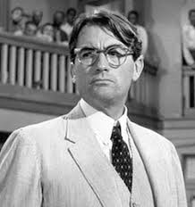
Closing argument for the defense
https://www.youtube.com/watch?v=C841wEogE4U

Slide 16
Cross-exam of Chutney Wyndham
https://www.youtube.com/watch?v=GSu7BGbyJqc

Slide 17
Questions?

